Slide 1
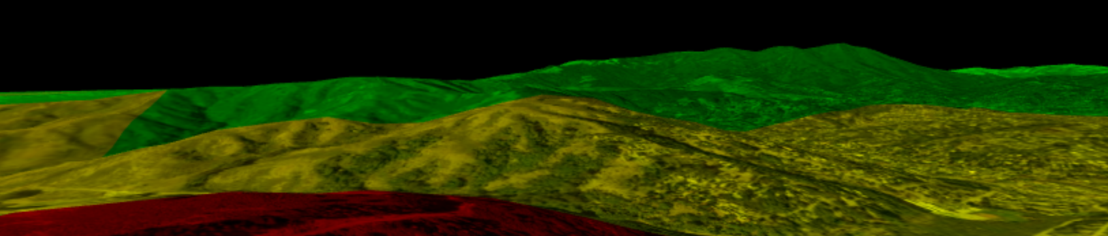
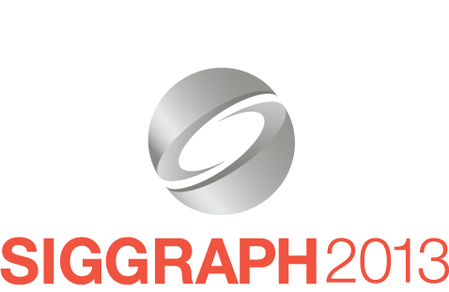
Rendering Gotchas in Massive Worlds
(Slides: cesium.agi.com/massiveworlds)
Patrick Cozzi, @pjcozzi
Analytical Graphics, Inc.
University of Pennsylvania

Slide 2
Introduction
Massive scale with fine-grained detail
Precision problems rendering artifacts
Issues
Global terrain – z-fighting
Earth-scale at meter resolution – jittering
Notes:
We’re going to look at some fundamental problems when rendering massive worlds. These problems are interesting – or perhaps even annoying – in that a typical graphics engine may never need to deal with them. However, when we scale our world up to a massive size and still want fine-grained detail, precision problems start to manifest themselves as rendering artifacts.
Over the years we’ve seen many forum posts like “I wrote a simple terrain engine and everything was great, but then I tried to cover world-wide terrain, and now there is z-fighting. Why?” and “I’m rendering the Earth using meters as units, and when I zoom in, static objects start to bounce around. Why?”

Slide 3
Introduction
Robust solutions
No fog
No bribing artists
Pragmatic implementation tips
Notes:
In this talk, we intuitively explain why, and present robust solutions that work for open worlds and make very few assumptions, e.g., we can’t necessarily put fog in the distant or ask artists to design a level such that the maximum view distance is only so far, e.g., add walls.
We’ve used these solutions in our 3D tools at Analytical Graphics, Inc. with great success. Some of them are well known and have been in use literally since I was in high school. Others are more recent. In both cases, I want to motivate their use and provide implementation tips.

Slide 4
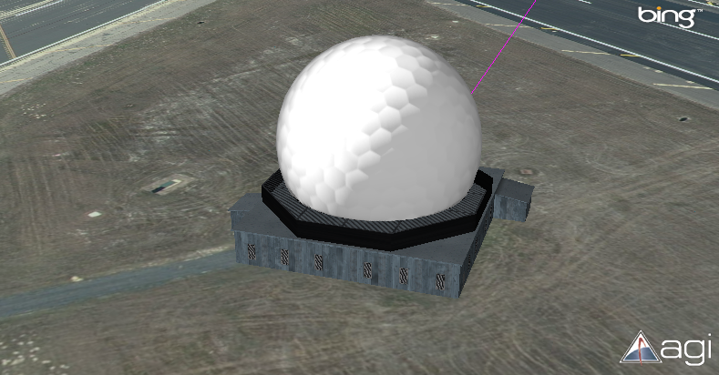
Our Work at AGI
High-resolution terrain and sub-meter imagery
Notes:
In our work at AGI, we model the real-world, from ground stations surrounded by high-resolution terrain and sub-meter imagery…

Slide 5
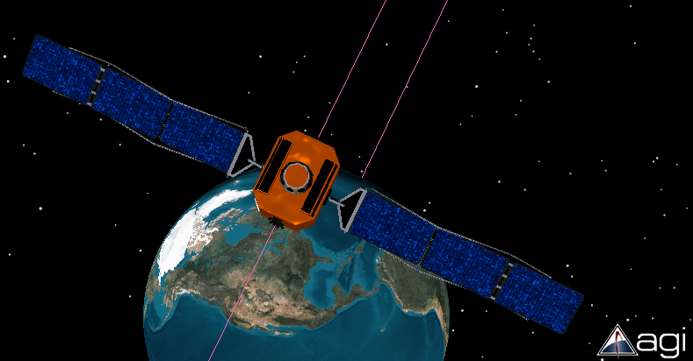
Our Work at AGI
Satellites at 40,000 km
Notes:
…to satellites in high-earth orbit at 40,000 km above the Earth…

Slide 6
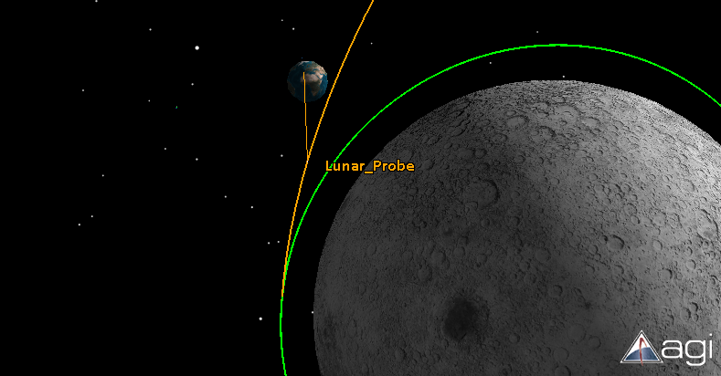
Our Work at AGI
Interplanetary missions
Notes:
…to interplanetary missions to the moon or mars.

Slide 7
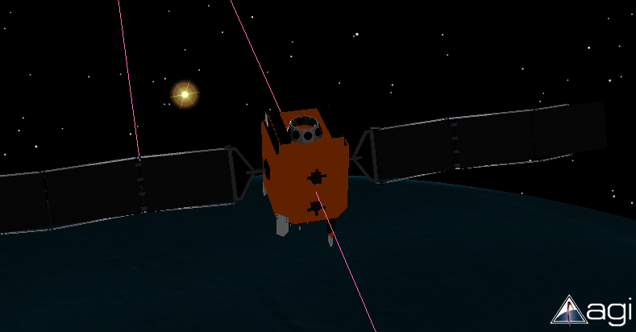
Our Work at AGI
Massive view distances and precision for coordinate systems
Notes:
These use cases require massive scale in terms of view distances and precision for coordinate systems. For example, we may be zoomed in close to a satellite orbiting the Earth, and still want to see the sun in the distance. Satellites have solar panels that point towards the sun. Or we may be zoomed in close to a satellite and want to be able to see the ground station that we are maintaining a communication link with.

Slide 8
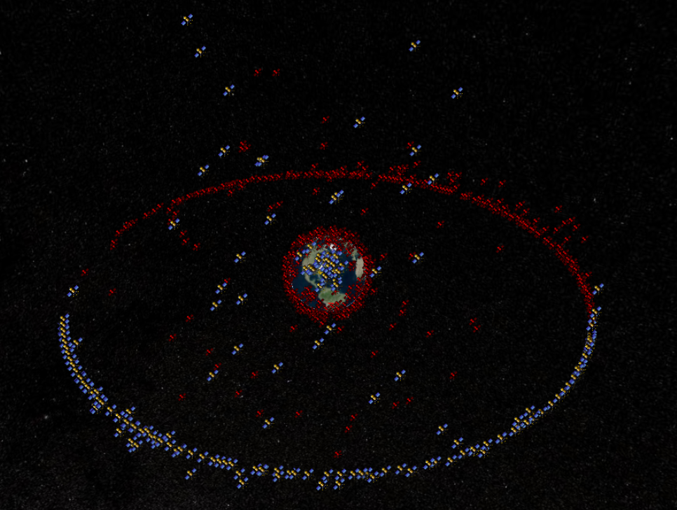
Our Work at AGI
Huge far-to-near ratio. No Fog!
Notes:
A lot of classic tricks like eliminating z-fighting by introducing fog in the distance to preserve a sane far-to-near ratio won’t always work for us. For example, some of our users want to see all the active unclassified satellites in space at the same time.

Slide 9
Applications
Virtual globes
Geospatial visualization
Massive-world games
…
Notes:
Today, I’m going to present rendering techniques we use to deal with these type of scale while still allowing fine-grained detail. In particular, we are going to solve two types of rendering artifacts:
z-fighting
jittering
The presented solutions are very general and apply to geospatial visualization like work done by Esri and virtual globes like Google Earth and NASA World Wind. They also apply to massive-world games.
We’ll start by looking at examples of z-fighting and jittering, then we’ll look at the cause of each, and solutions.

Slide 10
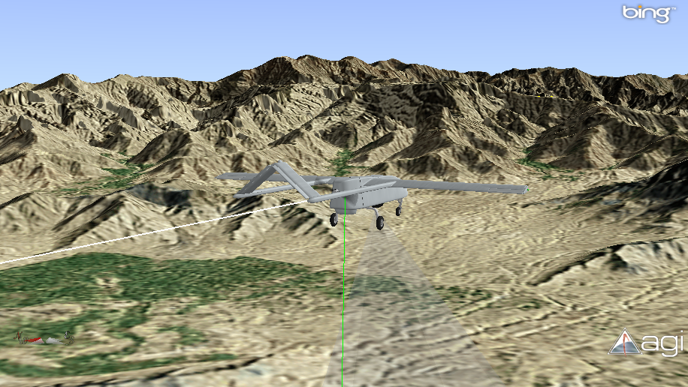
Z-Fighting
Shadow UAV mission without z-fighting
Notes:
Here we have a Shadow UAV flying a mission through the mountains.
There are no z-fighting artifacts in this image, but if we use a close near plane and a very distant far plane, we see z-fighting artifacts like these…

Slide 11
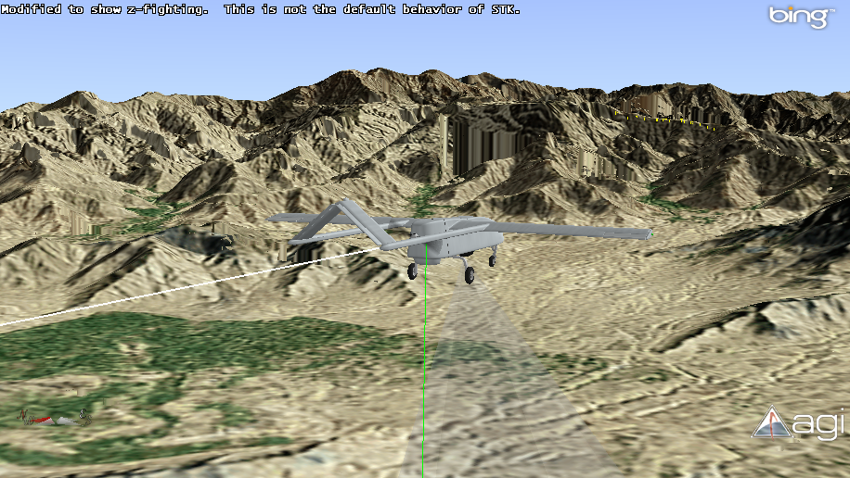
Z-Fighting
Close near plane and distant far plane
Video
Notes:
There is z-fighting throughout the distant mountains. I circled a few of the major areas. Terrain geometry is z-fighting with skirts used to prevent cracks.
Z-fighting is even more irritating when things are moving as shown in the video [videos/zfighting.wmv]. I promise that our software doesn’t do this by default; I hacked it to make the video.
Notice how there is no z-fighting closer to the viewer, for example, with the UAV or nearby foothills.

Slide 12
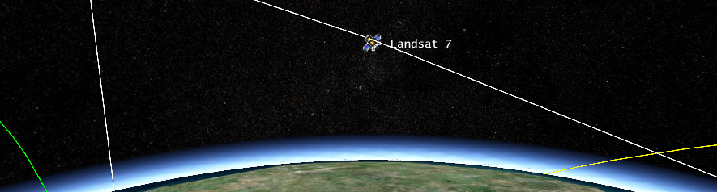
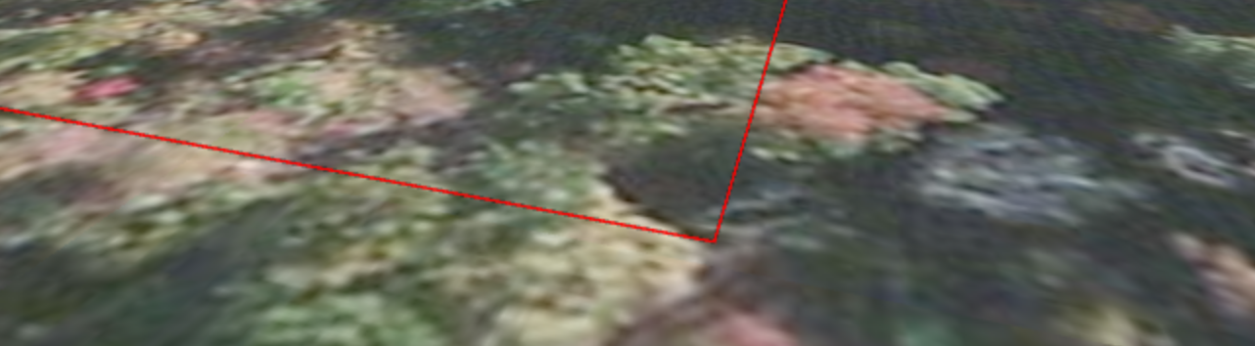
Jitter
Landsat 7. 700,000 m above Earth. Inertial reference frame.
State border. WGS84 reference frame.
Video
Notes:
The other artifact we’re going to look at today is jitter.
Here we have the Landsat 7, which is an imaging satellite in orbit at about 700,000 m above Earth. The billboard and text have the same world position. However, a small change in the viewer position results in the white polyline representing the satellite’s orbit, to bounce – or jitter..
Like z-fighting, jittering is most noticeable and irritating when things are moving. In this video [videos/jitter.wmv], we see a red polyline that looks innocent enough. As we zoom in and rotate, it starts to bounce around. This polyline represents the boundary for Pennsylvania, and it is defined in WGS84, which is a coordinate system that has an origin at the center of the Earth. Now we zoom out and see the Landsat 7 satellite again. With the video it is easy to see the polyline bounce up and down.
For this video, I modified our engine to show jitter for the polyline, but not for the billboard and text.

Slide 13
Z-Fighting Causes
Coplanar geometry
Reauthor, polygonOffset, or stencil
“Far apart” geometry can z-fight due to the non-linear relationship between z_{eye} and z_{window}
z_{eye} and z_{window} relationship is controlled by the f/n ratio
Bigger f/n: greater nonlinearity
Notes:
Now let’s take a closer look at z-fighting in massive worlds and solutions.
The classic z-fighting example is a piece of paper on a desk. If the paper and the desk are coplanar, we can see z-fighting artifacts due to floating-point round-off error. This particular case can be solved many ways including:
Slightly adjusting the geometry, either when authoring or in a view-dependent way at runtime with a call like polygonOffset [1]
Stenciling. Stencil out the paper. Render the desk. Render the paper.
However, z-fighting can occur when geometry is not coplanar, even when geometry is far apart – in some sense. This is due to the non-linear relationship between z in eye coordinates and z in window coordinates when using a perspective projection.
[1] http://www.opengl.org/archives/resources/faq/technical/polygonoffset.htm

Slide 14
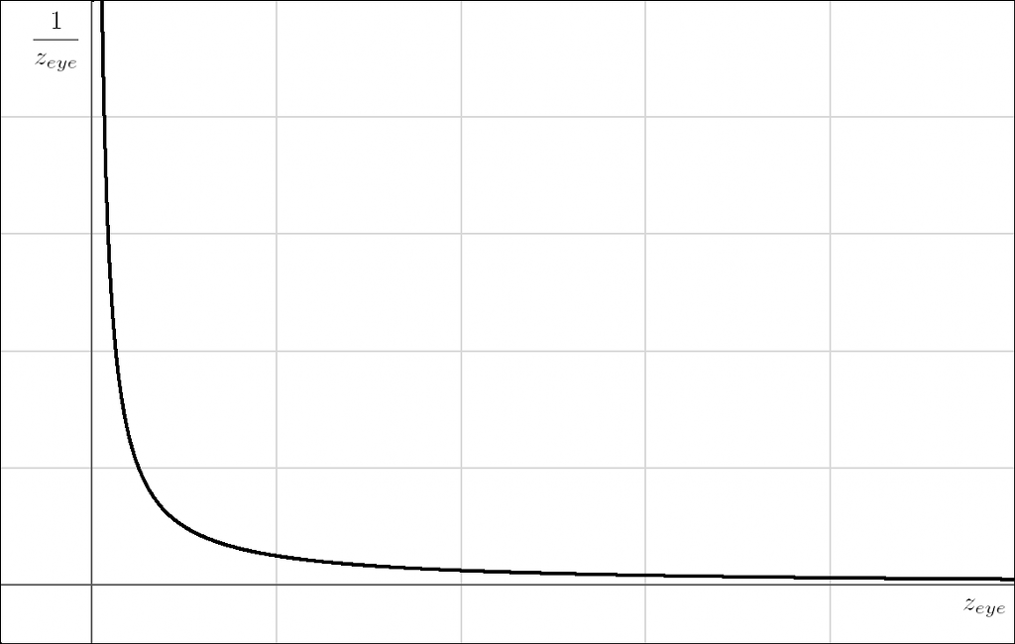
Z-Fighting Causes
z_{window} is proportional to 1/z_{eye}
Due to perspective division
Image courtesy http://www.virtualglobebook.com
Notes:
The relationship between z-eye and z-window is controlled by the far-to-near ratio. The bigger the ratio the greater the nonlinearity.
Why? When using perspective, if we multiply out the model-view-projection matrix, perspective division, and viewport transform, z-window becomes:
Z-window = ((((f + n) / (f – n)) + (2fn / z-eye(f – n))) + 1) / 2
(in the common case when the depth range near is zero and far is one).
For a given perspective projection, everything on the right-hand side is constant except for z-eye, therefore z-window is proportional to 1/z-eye. This is the result of the perspective divide, which causes perspective foreshortening, making objects in the distance appear smaller.
As we can see in the graph, a small change in z-eye when z-eye is small results in a big change in 1/z-eye because 1/z-eye is a quickly moving function here. That same change in z-eye when z-eye is large results in a smaller change to 1/z-eye because 1/z-eye is slowly moving then. In the later case, a small change to z-eye may yield the same z-window, creating rendering artifacts.

Slide 15
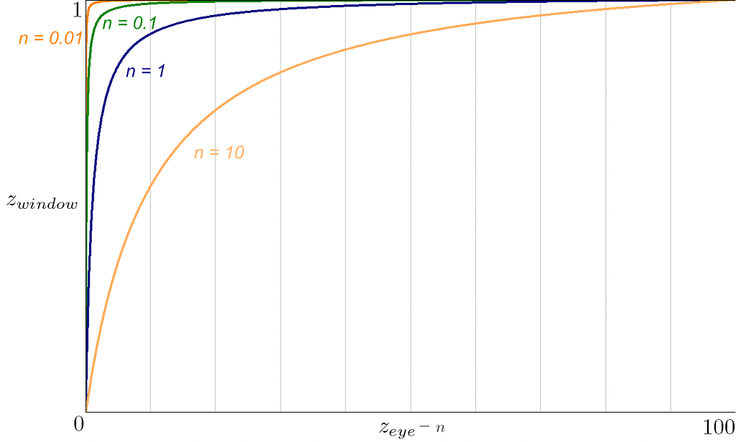
Z-Fighting Causes
Relationship between z_{window} and z_{eye} depends on n and f
Image courtesy http://www.virtualglobebook.com
Notes:
The relationship between z-window and z-eye also depends on the near and far distances as shown in this graph.
The x-axis is the distance from the near plane in eye coordinates, from 0 to 100. The y-axis shows z-window from 0 to 1. In all cases the view distance (f – n) is 100. Here we see that as n gets smaller, and hence the far-to-near ratio gets bigger, the precision gets pushed to the near plane.

Slide 16
Z-Fighting Causes
24-bit fixed-point depth buffer
f/n of 1,000 is acceptable [Akeley90]
Earth semiminor axis is over 6,300,000 meters
Want fine-grained detail
video
Notes:
A ratio of 1,000 is commonly considered acceptable for a 24-bit fixed-point depth buffer [Akeley90]. In practice, we’ve gotten away with higher values depending on how far apart geometry is. However, 1,000 or even 10,000 is not going to cut it for our massive worlds where Earth’s semiminor axis alone is over 6,300,000 meters.
In the video [videos/zfightingcauses.wmv], we keep pushing the near plane out to eliminate z-fighting between the plane and the globe. As we zoom in, we do not see z-fighting because precision gets better; however, if we zoom out, z-fighting will occur again.
Code: https://github.com/virtualglobebook/OpenGlobe (see Chapter06DepthBufferPrecision)

Slide 17
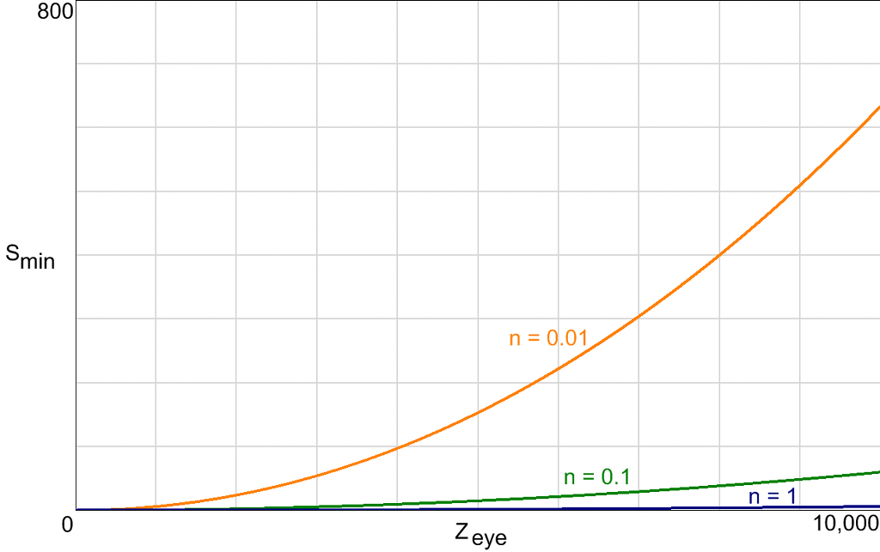
Z-Fighting Causes
Minimum Triangle Separation
Image courtesy http://www.virtualglobebook.com
Notes:
The minimum triangle separation, s-min, for a distance from the eye, z-eye, is the minimum world-space separation between two triangles required for correct depth occlusion.
[Baker99] provides an approximation to s-min for an x-bit fixed-point depth buffer:
S-min = (z-eye * z-eye) / ((2^x)n – z-eye)
[Akeley06] also show that window coordinate precision, field of view, and error accumulated by single-precision projection, viewport, and rasterization arithmetic contribute to effective depth buffer resolution.

Slide 18
Z-Fighting Solutions
Far-to-near tuning
Remove distant objects / imposters
Complementary depth buffering [TODO]
Logarithmic depth buffer [TODO]
Multiple frustums
Virtually unlimited view distances
Works on old hardware
Easy concept. Implementation requires some care
Notes:
Using multiple frustums for z-fighting is similar to z-partitioning in cascaded shadow maps with the light source directly behind the viewer. Like shadow maps, we’ll want to compute the farthest possible distance for the near plane (light frustum in shadow maps).
Cascaded shadow maps improve shadow map under-sampling where as we are using multiple frustums to overcome the distribution of z values.

Slide 19
Multiple Frustums
Farther the near plane, the bigger the frustum
A few frustums can cover a large view distance
Frustum 1: 1 to 1,000
Frustum 2: 1,000 to 1,000,000
Frustum 3: 1,000,000 to 1,000,000,000
Same fov and aspect ratio
Not to scale
In practice, we’ll overlap the frustums a bit.
Notes:
With a far-to-near ratio of 1,000, only a few frustums are needed to cover a large view distance. Three frustums can cover from 1 meter to a 1 billion meters.
Each frustum has the same field-of-view and aspect ratio, but a different near and far plane.

Slide 20
Multiple Frustums
Simple implementation
foreach frustum in back-to-front order
{
set projection matrix;
clear depth;
find objects that overlap frustum;
render objects;
}
Notes:
How many frustums are needed?
A common case may be 3 frustums and 300 objects. Each object is frustum culled 3 times, but if most objects are only in one frustum this is wasteful.

Slide 21
Multiple Frustums
Performance goals
Use the fewest frustums possible
Dynamic near/far plane
Minimize objects overlapping multiple frustums
Push out near plane
Minimize CPU overhead
Minimize frustum checks
Exploit temporal coherence
Notes:
Given that most objects will only overlap a single frustum, this can be more efficient. Let’s aim to:
Use the fewest frustums possible based on the needs of the current view, not a fixed near and far plane
Minimize the number of objects overlapping more than one frustum (by pushing out the near plane – and having a larger initial frustum)
Minimize CPU overhead

Slide 22
Multiple Frustum Rendering in Cesium
1) The scene produces commands that encapsulate draw calls
Command
Vertex array
Shader
Bounding volume
Render state
Framebuffer
Commands come from the terrain engine, 3D models, billboards, polylines, etc.
Notes:
Cesium is our open-source WebGL engine for virtual globes, which implements multiple frustum rendering.
The scene produces commands for the renderer to execute. In other literature, a command is also called a “draw call” or a “batch.” Commands may come from the terrain engine or other entitles like 3D models, billboards, or polylines.
A command has everything needed to execute a draw call using the underlying graphics API – WebGL in our case. Our engine has both DrawCommands for issuing drawElements/drawArrays calls and ClearCommands for clearing the framebuffer. Here, we’re just concerned with DrawCommands, which have:
Vertex array, offset, and count
Shader program and its uniforms, including a model matrix
Render state that defines the fixed-function state of the pipeline
Framebuffer, which is the target of the draw call
Strictly speaking, the bounding volume is not used for issuing the draw call, but it is needed for determining what frustums a command belongs to. Any bounding volume could work, but we use spheres everywhere for now.
Code: https://github.com/AnalyticalGraphicsInc/cesium/blob/b16/Source/Renderer/DrawCommand.js

Slide 23
Multiple Frustum Rendering in Cesium
2) Walk through commands
Cull¹
Compute
Min near distance
Max far distance
Application distances define extremes
Max far
Min near
App near
App far
¹If it wasn’t already; the scene culls some commands hierarchically
Notes:
The near and far plane distances can varying frame-to-frame. The farther we can push out the near plane and the closer we can bring in the far the plane, the fewer frustums we will have. So instead of just using the application-defined near and far distances, we compute them dynamically using each command’s bounding volume and the application-defined distances as extremes.
In our engine, we do both frustum culling and horizon culling, which is occlusion culling with the ellipsoid, as Kevin will discuss in the following talk.
We don’t need to check the far plane in this cull pass.
Code: createPotentiallyVisibleSet() in https://github.com/AnalyticalGraphicsInc/cesium/blob/b16/Source/Scene/Scene.js

Slide 24
Multiple Frustum Rendering in Cesium
3) Given desired far-to-near ratio, determine the number of frustums
var numFrustums = Math.ceil(
Math.log(far / near) / Math.log(farToNearRatio));
for (var m = 0; m < numFrustums; ++m) {
var n = Math.max(near, Math.pow(farToNearRatio, m) * near);
var f = Math.min(far, farToNearRatio * n);
// ...
Notes:
Code: updateFrustums() in https://github.com/AnalyticalGraphicsInc/cesium/blob/b16/Source/Scene/Scene.js

Slide 25
Multiple Frustum Rendering
4) Walk through commands, and assign them to frustum(s)
Can combine with Step 2 in a single pass over the commands by exploiting temporal coherence – using the frustums computed from the previous frame
Notes:
Now that we know the length of each frustum, we can walk through the commands again, and assign to them frustums that they overlap. As we’ll see some commands will wind up in more than one frustum.
So far, the renderer has made two passes over commands – the first pass culls and computes the frustums, and the second pass assigns commands to frustums. A typically application will have 100s to 1,000s of commands so it would be nice to be able to do this in a single pass. We can by exploiting temporal coherence.

Slide 26
Multiple Frustum Rendering
4) Temporal Coherence Criteria
near_{t} >= near_{(t – 1)}
far_{t} <= far_{(t – 1)}
numFrustums_{t} == numFrustums_{(t – 1)}
far_{(t – 1)}
near_{(t – 1)}
near_{t}
far_{t}
Notes:
It is very likely that the frustums computed in the previous frame can be used in the current frame. We define our acceptance criteria as:
desired near >= previous near
desired far <= previous far
desired number of frustums == previous number of frustums
Code: createPotentiallyVisibleSet() and insertIntoBin() in https://github.com/AnalyticalGraphicsInc/cesium/blob/b16/Source/Scene/Scene.js

Slide 27
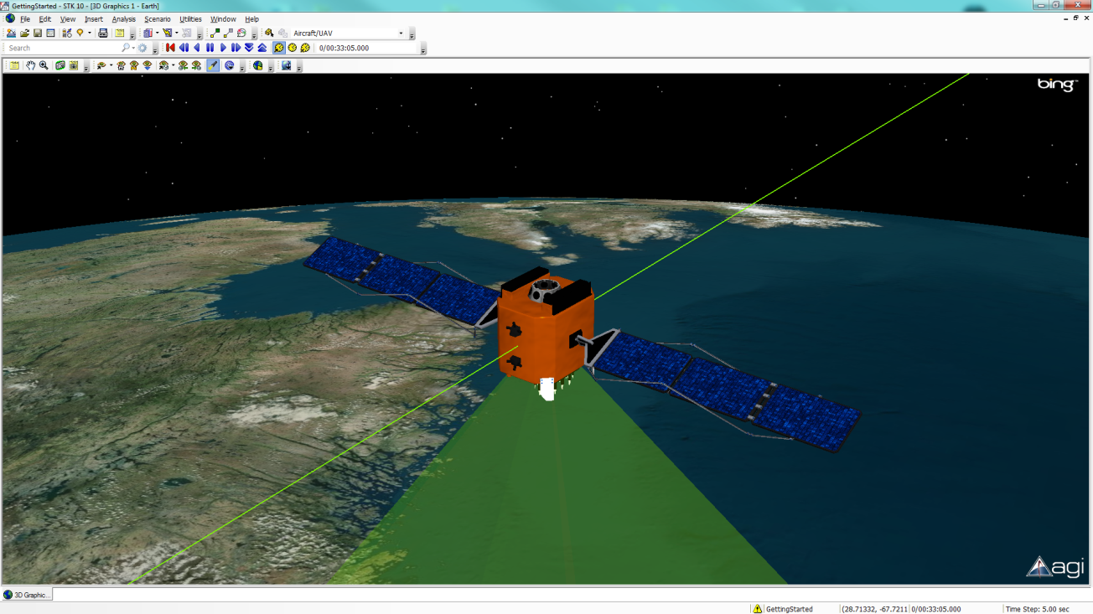
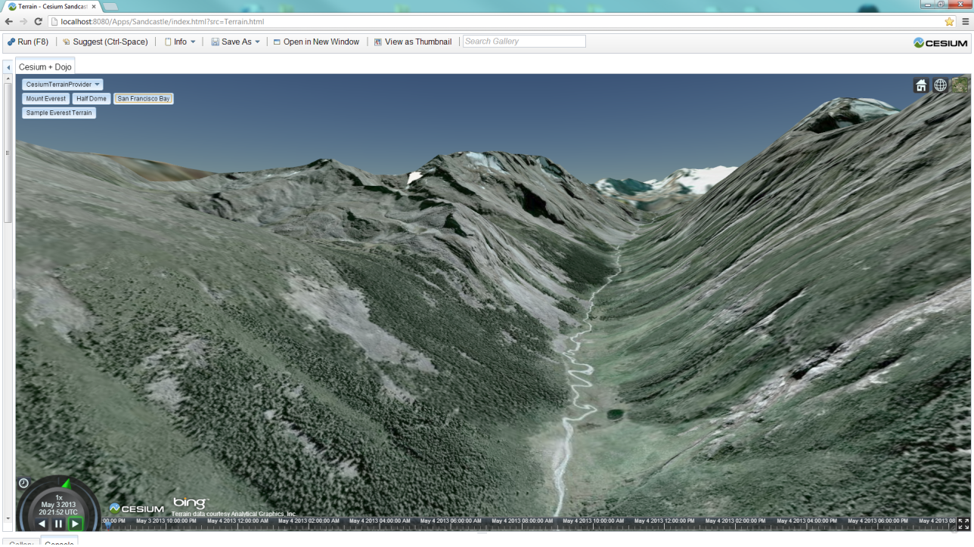
Multiple Frustum Rendering in Cesium
Good coherence using
application-defined near distance
Poor coherence when zooming in
Notes:
Coherence can be really good, especially when the user-defined near distance is used because the closest bounding volume intersects it because, for example, the viewer is deep in the mountains or following a satellite as shown here. This is a lot of our use cases.
Coherence is not so good in other cases, like, when zooming in to an object because the desired near distance keeps getting smaller and smaller.
We could improve coherence by scaling the computed near/far to be slightly farther apart, but this runs the risk of requiring new frustums.

Slide 28
Multiple Frustum Rendering in Cesium
2-4) Walk through commands
Frustum cull
Assign commands to previous frame frustums
Compute desired near/far distance
Compute new frustums and repeat if new frustums are needed
Notes:
So Steps 2-4 are really combined into a single pass over the commands. We cull a command as before, then assign it to frustum(s) using the previous frame’s frustum. As we walk through each command, we still compute the desired near/far distances. Then we use these to determine if the previous frame’s frustums will work. If they won’t we compute new frustums, and call the function again knowing that the computed frustum will work.

Slide 29
Multiple Frustum Rendering in Cesium
Render like we did before
foreach frustum in back-to-front order
{
set projection matrix;
clear depth;
render commands overlapping this frustum;
}
Notes:
Now we know the tight near/far distances and the commands in each frustum

Slide 30
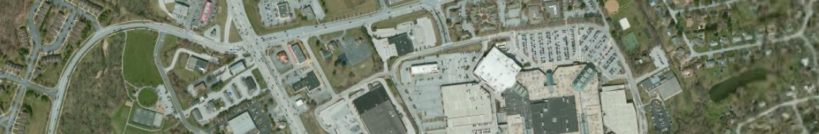

Multiple Frustum Artifacts
Artifacts without frustum overlap
video
Notes:
If adjacent frustums do not overlap slightly, we’ll see tearing artifacts where the near plane of one frustum meets the far plane of the closer frustum. In the lower image here, we see several tears revealing the background color where two frustums meet.
When we first saw this artifact, we thought it was a driver bug, but we saw it across hardware vendors. With the near plane of a frustum equal to the far plane of the closer frustum, I can imagine one pixel artifacts, but these artifacts are much larger.
To solve these, we move the near plane of each frustum, except the closest, slightly closer.
Code: updateFrustums() in https://github.com/AnalyticalGraphicsInc/cesium/blob/b16/Source/Scene/Scene.js
Video: videos/frustumOverlap.wmv

Slide 31
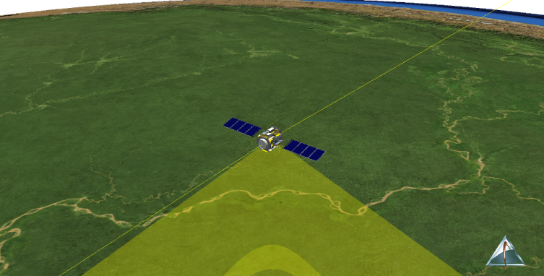
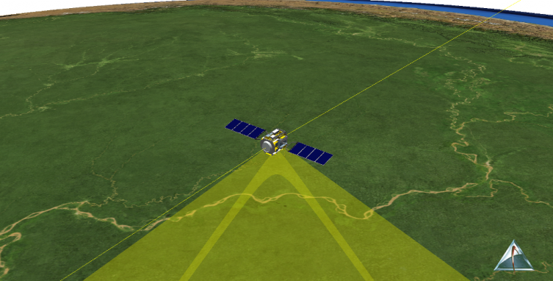

Multiple Frustum Artifacts
Artifacts with frustum overlap
Image courtesy http://www.virtualglobebook.com
Notes:
Overlapping frustums creates a new artifact for objects rendered with blending. In our engine, we render a lot of large translucent objects to represent sensors, e.g., a view volume of a camera attached to a satellite. Since these objects are large, they often overlap more than one frustum. Since they use alpha blending for translucency, the blending occurs twice where the frustums overlap leading to artifacts that can appear to slide back and forth when the viewer zooms.
It should be possible to eliminate these artifacts with the stencil buffer, but we haven’t investigated it yet.

Slide 32
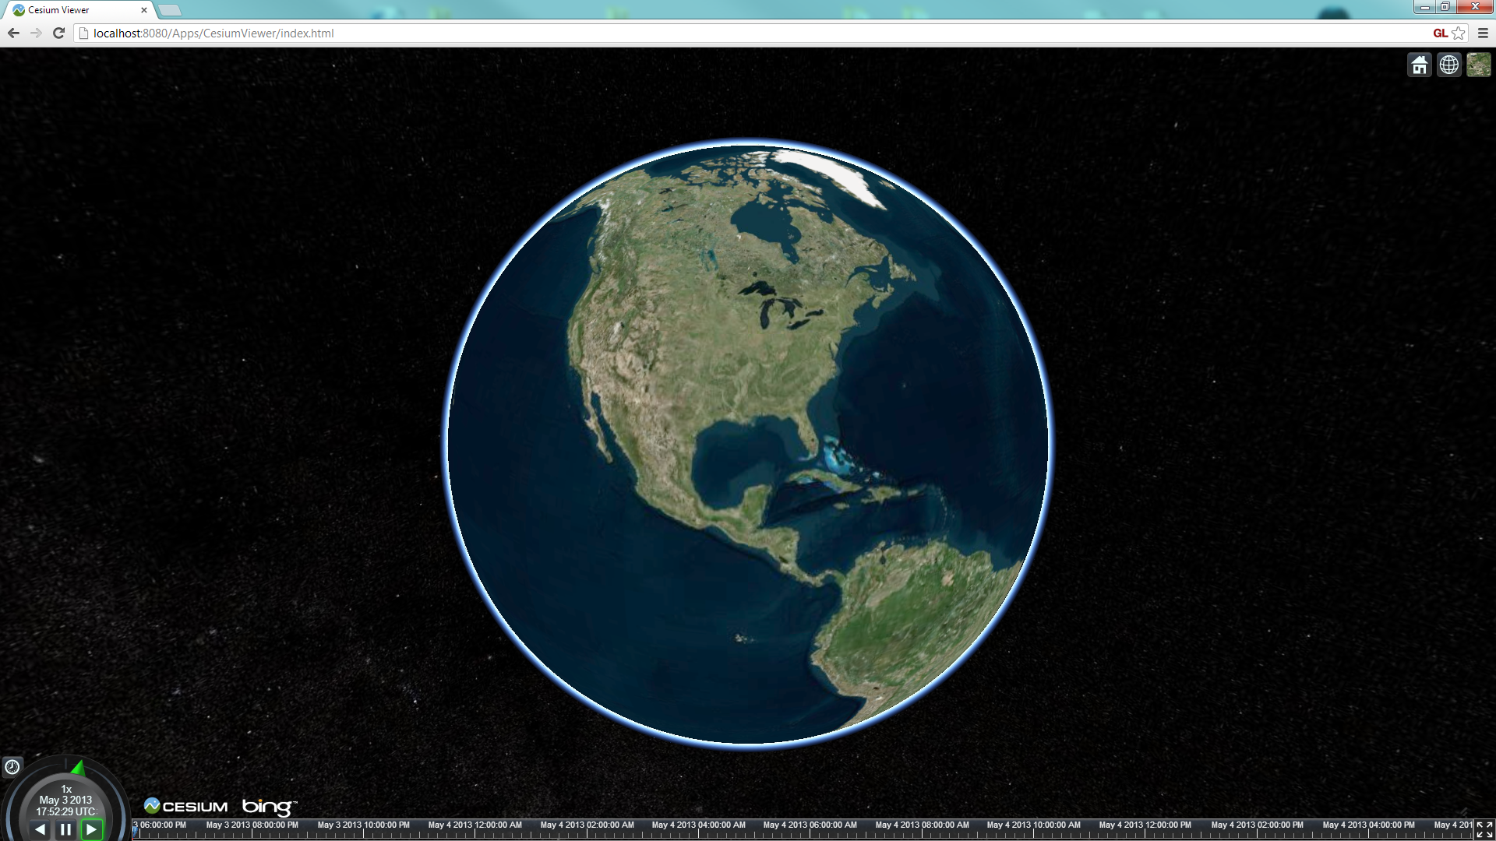
Performance: Redundant Draw Calls
1 Frustum. 14 Commands
Notes:
When a bounding volume overlaps more than one frustum, not only does it have the potential to create artifacts, but it leads to commands being executed redundantly, that is, executing draw calls for the same object in more than one frustum. How, it’s actually not as bad as you’d think. Let’s look at a few different scenes.
For this full world view, we execute 14 commands (ignoring clears, the sky box, and 2D overlays). They all fit within one frustum because we are able to dynamically push the near plane back really far, which allows the first frustum to be large enough to include the entire globe.

Slide 33
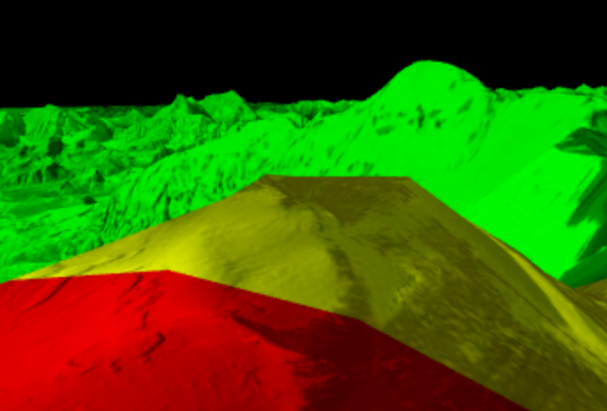
Debug View
Frustum 1 - red
Frustum 2 - green
Frustum 3 – blue
1 + 2 – yellow
2 + 3 - cyan
1 + 2 + 3 - white
Notes:
This view is useful to visualize where frustum boundaries are (which move with the camera) and to see how many commands are in more than one frustum like the yellow above.

Slide 34
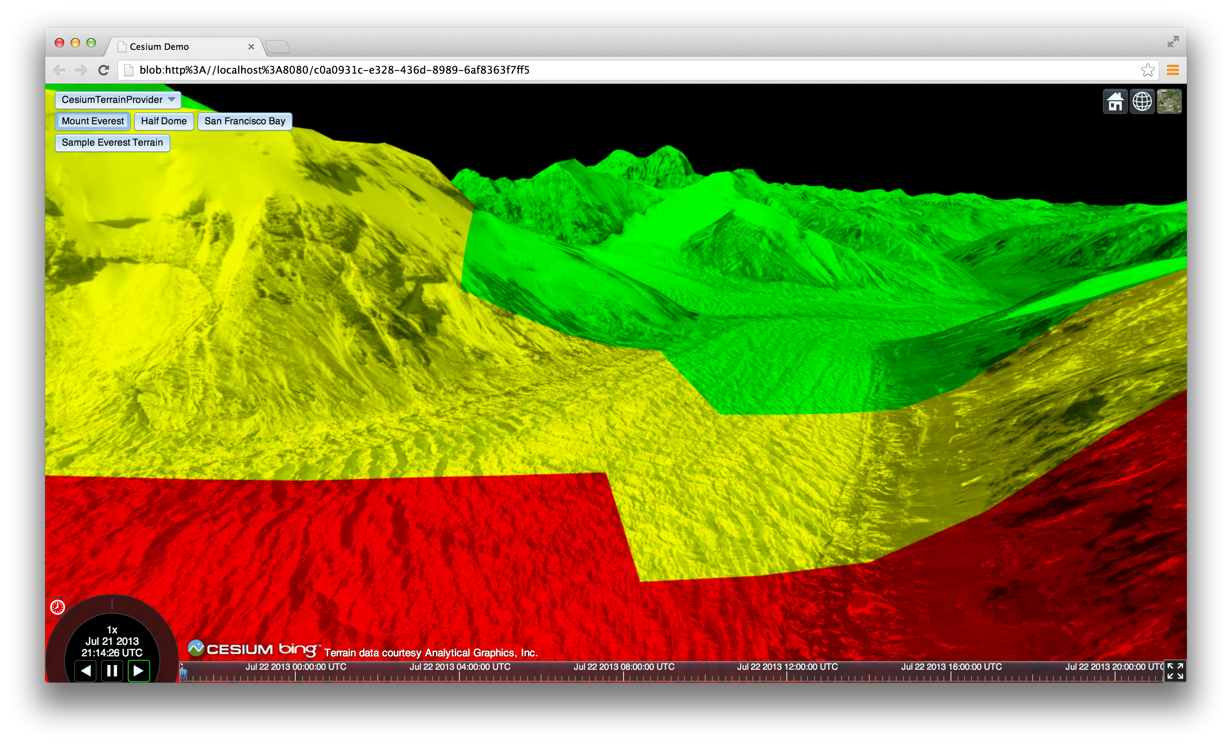
Performance: Redundant Draw Calls
2 Frustums. 109 Commands. 21 executed twice
Notes:
Here we are zoomed in much closer to the ground looking at Mount Everest. For this scene, we execute 109 commands (horizon views are always a challenge; note there is no fog here allowing us to not draw distant tiles). 21 are executed twice.

Slide 35
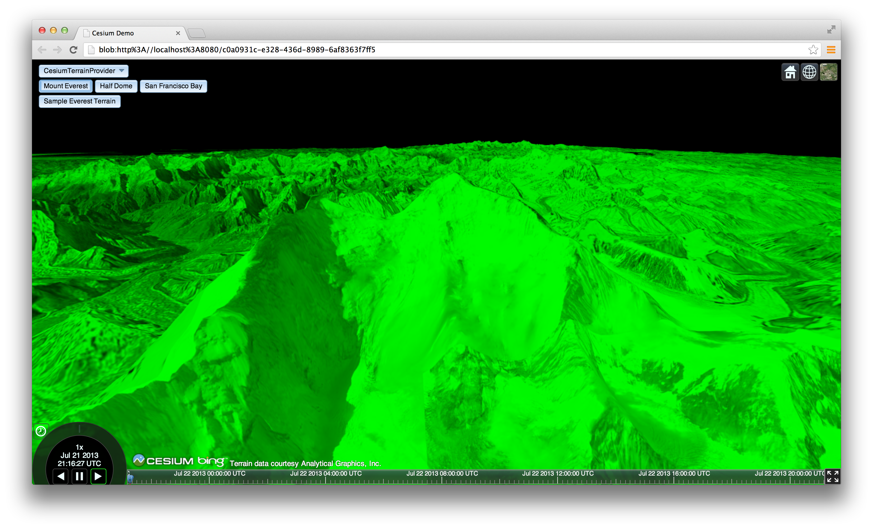
Performance: Redundant Draw Calls
2 Frustums. 83 Commands. 2 executed twice (not visible)
Notes:
Not all horizon views are that bad. Here we are looking at Mount Everest. Out of the 83 commands, only 2 are executed twice. Those 2 pass view frustum culling but don’t actually result in any pixels.

Slide 36
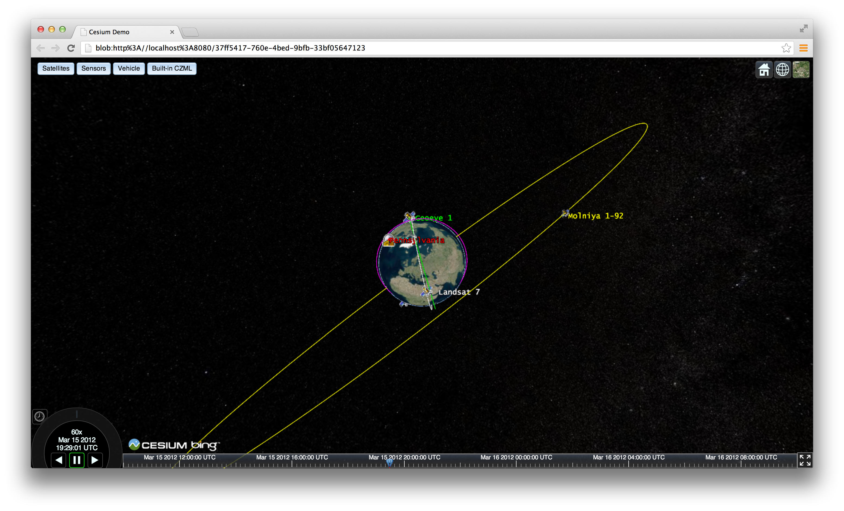
Performance: Redundant Draw Calls
3 Frustums. 6 Commands. 2 executed three times
Notes:
We’re not always this lucky with redundant calls. For example, we are high in space in this scene. We need three frustums total.
This scene only needs six commands, but two of them execute in all three frustums. Can you guess which? The billboards for the satellites are batched together as are the labels for the satellites. Since the bounding sphere for these includes the Molniya orbit high in space and right in front of the viewer – which peaks at 40,000 km above the globe, and the Geoeye in low earth orbit. This creates a huge bounding volume that overlaps all three frustums.

Slide 37
Performance: Batching vs. Culling
Bigger batch
Bigger bounding volume
More likely to overlap multiple frustums
Need tight bounding volumes, e.g., [Ohlarik08]
We still prefer to aggressively batch
Notes:
Everything needs to have a bounding volume. For something dynamic like a particle system, the bounding volume doesn’t have to be recomputed every frame, it can encompass the particles expected position over their lifetime.
This shows that there is tension between batching and culling even more so when using multiple frustums. Traditionally, to make the best use of the GPU, and minimize CPU overhead, we always try to reduce the number of draw calls we make during a frame by batching. When we introduce multiple frustum rendering, batching generally increases bounding volume sizes, making it more likely that a command (batch) will need to be executed in more than one frustum, which increases the number of draw calls. Given that applications built on our engine are almost always CPU bound, we still see a win by batching aggressive even if it leads to some redundant draw calls.

Slide 38
Future Ideas
Size frustums to minimize command overlap
Similar to kd-tree splitting plane
Minimize overlap and maintain far-to-near ratio
Use application CPU time in hopes of less draw calls
Better temporal coherence
Like loose octrees

Slide 39
Acknowledgements
Dan Bagnell
Ed Mackey, @emackey
Deron Ohlarik
Notes:
Ed did our original multi-frustum implementation in the late 90s. Dan did most of the recent implementation work in Cesium, our WebGL engine.

Slide 40
Course Resources
cesium.agi.com/massiveworlds
Notes:
Slides, videos, etc.

Slide 41
References
[Akeley90] Kurt Akeley. The Hidden Charms of the z-Buffer. IRIS Universe, 1990.
[Akeley06] Kurt Akeley and Jonathan Su. Minimum Triangle Separation for Correct z-Buffer Occlusion. Graphics Hardware, 2006
[Baker99] Steve Baker. Learning to Love Your z-Buffer. 1999
[Cozzi11] Patrick Cozzi and Kevin Ring. 3D Engine Design for Virtual Globes. A K Peters, Ltd., 2011
[Ohlarik08] Deron Ohlarik. Bounding Sphere. 2008
Notes:
In addition to these references, also see the implementation notes with pseudo-code for our engine - https://github.com/AnalyticalGraphicsInc/cesium/wiki/Data-Driven-Renderer-Details

